Slide 1
Unit - I
Introduction to micro economics

Slide 2
Language of Economics
Resources - All the scarce material is called resources (Free vs Economic resources) – Land, Labour, Capital, Gold, Crude oil
Economy – An area in which people make or produce goods & services – Indian Economy
Production – An activity designed to satisfy peoples’ want – Done by producers
Consumption – Using up goods & services to satisfy our wants – Done by consumers
Distribution/Exchange – Buying & selling of goods &services
Economic agents – Firms, households, government

Slide 3
What is Economics?
Economics is about……….
Scarcity – Needs Vs Wants
Resources – Allocation of resources
Opportunity Cost (Trade-off) – is the opportunity lost – The cost of choice
Producers (firms) & consumers (households)
Supply & demand – Firms & consumers
Trade & exchange – How trades makes everyone better off?
Markets
Economics is the study of how individuals and societies choose to use the scarce resources that nature and previous generations have provided.

Slide 4
Identify what is scarce here?
Laptops
US $
Doctors
Diamonds
Air
Flats in Jaipur
Sunshine
Creativity

Slide 5
Why study economics?
To learn economic way of thinking:
People responds to incentives – Self interest
Optimal decisions are made at margin
NO free lunch – It is impossible to get something for nothing - Efficient markets
A choice is trade-off (opportunity cost)
People make rational choices
Ceterius paribus – Other things remaining constant/same

Slide 6
Other reasons
To understand society – Rich vs poor nations, New innovations and jobs (facebook, youtube)
Most of the nation’s and world’s significant social problems have an economic dimension
To understand current global affairs – Ex- Barbie doll Made in China, Greece crisis, India & China’s role in world economy
To be an informed citizen – Recession after 2008, understanding government policies, fuel prices, rupee depreciation against dollar etc.
Choosing your life’s occupation – You will know why you are unemployed?
It is a subject of inquiry – Develops good analytical skills and problem solving skills - Noble prize in Economics
Disclaimer - Economics will not make you a genius.

Slide 7
1.1 Economics – An Introduction
The word ‘Economics’ was derived from the Greek words ‘Oikos’ (a house) and ‘Nemein’(to manage), which meant managing a household, using the limited money or resources a household has.

Slide 8
Origin of Economics
Earlier, it used to be called as Political Economy.
The early writers used the term “Political Economy” for the management of the State.
Indian scholar and philosopher, Chanakya (Kautilya) in his famous book ‘Arth-Shastra’ has examined both kinds of activities, i.e. economics and political.
Greek philosopher Aristotle had used the term economics to mean the management of ‘family and the state’.
Dr. Marshall was the first to use the term ‘economics’ in 1890 in his famous work “Principles of Economics”.

Slide 9
Development of Economics as a subject
Adam Smith, the Founder of Modern Economics, shaped the form in which we study economics today.
His famous book “An Enquiry into the Nature and Causes of Wealth of Nations”, published in 1776, is still acclaimed even today.
Till the end of 18th and the mid of the 19th century (1776 – 1850), several great Economists like Ricardo, Malthus, J. B. Say, etc., had fully supported the thoughts of Adam Smith. These economists are known as classical economists.

Slide 10
From the middle of 19th century to the first three decades of the 20th century (1850-1930) economists like Menger, Walras, Cournot, Marshal, Pigou, etc., had made significant contributions to the development of the study of Economics. (Neo-classical economists)
In 1933, Prof. Ragnar Frisch, a famous economist of Oslo University, Norway, divided the study of economics into two parts:
i) Micro Economics, and
ii) Macro Economics

Slide 11
DEFINING ECONOMICS
It is difficult to give an accurate definition of economics.
Barbara Wooten once remarked, Whenever six economists gather there are seven opinions.
Zuethen once said, - Economics is an unfinished science.

Slide 12
Different approaches on definition
There are two distinct approaches of the economists in respect of the definition of economics
One school of thought says that there is no need of defining Economics.
Another school of thought emphasizes the necessity of defining Economics.

Slide 13
According to some modern economists, the subject of economics has been growing continuously.
It will, therefore, be improper to limit its growth to the confines of a given definition.
There is no need of defining it.
According to Gunnar Myrdal, - Such definitions are both unnecessary and undesirable.

Slide 14
However, many of economists agree with the view that defining Economics is a must.
Eric Roll is of the view that for a scientific study of a subject, knowledge of its definition is as much essential as the knowledge of the boundaries of a farm to be cultivated.
By giving a precise definition of Economics, it becomes possible to study it scientifically and properly.

Slide 15
But there are so many definitions of Economics that J. N. Keynes was obliged to remark, - Economics is said to have strangled itself with definitions.
In order to facilitate their study, definitions of Economics have been broadly divided into four parts:

Slide 16
Definitions of Economics
Wealth
Definition
(Adam Smith)
Welfare
Definition
(Alfred
Marshall)
Scarcity
Definition
(L. Robbins)
Growth
Oriented
Definition
(Samuelson)

Slide 17
1. Wealth centered definition
Classical Economists like Adam Smith, J. B. Saw, Walker, J. S. Mill defined economics related to wealth.
Adam Smith, who is generally regarded as father of economics, defined economics as “a science which enquires into the nature and cause of wealth of nation”.
He emphasized the production and growth of wealth as the subject matter of economics.
Economics had not developed as an independent and important study before the publication in 1776 of the famous book of Adam Smith titled - An Enquiry into the Nature and Causes of Wealth of Nations.

Slide 18
2. Welfare & Material centered definition
Neo-classical economists like Marshall, J. S. Mill, Pigou, and Cannan, etc., have included in the scope of economics those activities of man, which are undertaken to acquire material goods that promote the welfare of mankind.
According to A. Marshall “Economics is a study of mankind in the ordinary business of life; it examines that part of individual and social action which is most closely connected with the attainment and with the use of material requisites of well being”.
Welfare-related definitions stress the fact that Economics does not study wealth alone rather it studies human welfare as well.

Slide 19
3. Scarcity centered definition
Austrian economists Menger and Petter, and English economist Stigler had given scarcity-related definitions of Economics but it was examined in detail by Prof. Robbins in his book - An Essay on the Nature and Significance of Economic Science, published in 1932.
According to Lionel Robbins: “Economics is the science which studies human behavior as a relationship between ends (wants) and scarce means (resources) which have alternate uses”.

Slide 20
4. Growth/development centered definition
In the words of noble prize winner Prof. Samuelson “Economics is the study of how men and society choose with or without the use of money, to employ the scarce productive resources which have alternative uses, to produce various commodities over time and distribute them for consumption now and in future among various people and groups of society”.

Slide 21
WHICH OF THESE DEFINITIONS IS THE BEST?
Different economists have given different definitions of Economics.
Boulding is of the opinion that any single concise definition of Economics will be inadequate.
Picking up the term ‘wealth’ from the definition of Adam Smith, ‘welfare’ from that of Marshall, ‘scarcity’ from that of Robbins and ‘economic growth’ from that of Samuelson, an acceptable definition of Economics can be constructed in these words:

Slide 22
Mixed definition
“Economics is a subject that studies those activities of man which are concerned with the maximum satisfaction of wants or with the promotion of welfare and economic growth by the efficient consumption, production and exchange of scarce means having alternative uses.”

Slide 23
Definition
Economics is the study of how societies use scarce resources to produce goods and services and distribute them among different individuals.
Economics is “the study of the behavior of human beings in producing, distributing and consuming material goods and services in a world of scarce resources.” (McConnell, 1993)

Slide 24
Concept of economics
Economics relates to:
Economic activities – Production, Consumption, Exchange (product & factor pricing)
Economic system – Capitalism, Socialism, Mixed Economy
Economic policies – Monetary, Fiscal

Slide 25
Review question
Watching a movie is an example of “consumption.”
True

Slide 26
Scope of economics
Microeconomics: Concerned with the behavior of individual entities such as markets, firms and households.
Microeconomics is about decision making by individual consumers & firms, and about how resources are priced and allocated through markets
b. Macroeconomics: Concerned with the overall performance of the economy.
This concept came into being after 1935 when General Theory of Employment, Interest and Money was published by John Maynard Keynes.

Slide 27
Scope of Microeconomics
Theory of consumer behaviour
Theory of Production and Cost
Theory of Factor Pricing
Theory of Economic Welfare

Slide 28
Scope of Macroeconomics
Theory of income and employment
Theory of consumption & investment
Theory of business cycles
Theory of general price level
Theory of economic growth
Theory of international trade

Slide 29
Difference
Basis | Micro Economics | Macro Economics
Unit of Study | Individual | Aggregate
Method | Slicing | Complete
Subject Matter | Study of product and factor pricing | Study of National income, general level of prices, business cycle
Basis | Based on independence | Based on Interdependence
Core of study | Price Theory | Income
Advocated by | Alfred Marshall | John Maynard Keynes
Vision | Worms eye view : study of a tree | Birds eye view: Forest as a whole
Approach | Individualistic | Aggregative
Objective | Allocation of resources | Full empt. & growth
Quality of Analysis | Simple and easy | Difficult and complicated

Slide 30
Examples
What determines the inflation rate?
What determines the production of DVDs?
What factors determine the price of petrol?
What determines the wage of auto workers?
Why are people buying more mobile phones?
Why did unemployment increase in 2008 and 2009?
Why did Japan’s economy stagnate during the 1990s?
Can the Reserve Bank of India bring prosperity by keeping interest rates low?

Slide 31
Review question on micro & macro economics
Consider a big event, such as, Cricket World Cup final match at Eden Garden stadium of Kolkata in India.
From a micro economic point of view:
What are the factors influencing demand and supply of tickets?
Is the market for tickets is competitive or monopolistic?
From a macro economic point of view:
How might a big event affect tourism, spending and hence inflation rates and exchange rates?
How might a big event be affected by influences such as aggregate demand or interest rates?

Slide 32
1.1.2 Logic of economics/Nature/ Economic statements
Economics is a popular, useful and significant social science.
It involves economic activities of man.
Economists use the scientific approach to understand economic activities
Observation of facts,
Measurement,
Explanation (cause-effect)
Verification.
Economics relies upon laws and theories for analysis

Slide 33
Is economics only a positive or normative Science?
With regard to the nature of economics, another question that arises is whether it is only a positive science or a normative science.
Economists are not unanimous in this respect.
According to Robbins, Friedman etc. economics is only a positive science.
On the other hand, Marshall, Pigou, Hawtrey etc. are of the opinion that it is both a positive and normative science.

Slide 34
Positive economics / statements
Positive economics is the study of what and why an economy operates as it does.
Positive economics (statements) deals with matters of fact or they question about how things actually are.
Positive statements are made without obvious value-judgements and emotions.
Positive economics can be described as “what is, what was, and what probably will be”
Statements are based on economic theory rather than raw emotion.

Slide 35
Examples
The Chinese economy now has lower population growth rate than India.
The Indian stock market has boomed in 2014.
India is an over-populated country.

Slide 36
Unscrambling Cause and Effect
Economists are particularly interested in positive statements about cause and effect. Are computers getting cheaper because people are buying them in greater quantities? Or are people buying computers in greater quantities because they are getting cheaper?
To answer such questions, economists create and test economic models.

Slide 37
Descriptive eco. & economic theory
Positive economics is often divided into descriptive economics & economic theory.
Descriptive economics is simply the compilation of data that describes the facts Ex – factual data on Indian Economy.
An economic theory (Micro Eco., Macro Eco.) is a model or statement or set of related statements about cause and effect, action and reaction – Ex – Law of demand.

Slide 38
Normative economics/statements
Normative economics is the study of how the economy should be. It is also known as Policy economics.
Normative statements are subjective - based on opinion only - often without a basis in fact or theory. They are value-laden, emotional statements that focus on "what ought to be".
Examples:
Planning commission should not be replaced.
The national minimum wage rate should be increased to reduce poverty
Agricultural income should also be taxed.
Food grains should be given at lower price to the poor families.

Slide 39
Fallacies – Improper conclusion
Post hoc fallacy – Assumes because one event occurred before an other event, the first event caused the second event.
Ex: This fallacy is often apparent when a newly elected government takes credit for improving the economy. Since the economy improved after the election, the election result must have been responsible.
Fallacy of composition – What is true for the part is also true for a whole, you are committing the fallacy of composition.
Ex: A farmer who is better off because he has a bumper crop but may not be better off if every farmer has one.

Slide 40
1.1.3 Economic systems
An economic system is a mechanism which deals with the production, distribution and consumption of goods and services in a particular society and comprises of people, institutions and their relationships.
It addresses the problems like the allocation or scarcity of resources.

Slide 41
Market, Command and Mixed Economies
Market Economy: Where individuals and private firms make the major decision about production & consumption. It may also be called lassiez-faire economy. Ex - America
Command Economy: Where the Government makes all important decisions about production & distribution. Ex - Soviet Union. It may be called as communistic economy as well.
Mixed Economy: Where the decision pertaining to production, consumption & distribution are taken by the Government as well as the individual such a market is called to have a mixed economy. Ex- India

Slide 42


Economic Systems
Pure
Command
Pure
Market
Mixed Economy

Slide 43
Economic Systems
United Kingdom
79%
Germany
71%
Russia
51%
0
100
Pure
Command
Pure
Market
Mixed Economy
Notes:
6th Grade- This information is meant to be used in conjunction with the 6th and 7th grade Teacher Notes. For additional resources, go to GeorgiaStandards.org. (Note: This is not an expectation for students to memorize numbers, but to understand that factors that influence specific countries to move more towards a command or market economy). The numbering system is based on The Heritage Foundation’s Economic Freedom Index 2009 The Heritage Foundation is a conservative organization that has partnered with the Wall Street Journal for over a decade to evaluate each country based on a set of 10 criteria to determine economic freedom. Update information using resources listed in the Teacher Notes.

Slide 44
Economic Systems
Canada
81%
Brazil
57%
Cuba
28%
0
100
Pure
Command
Pure
Market
Mixed Economy
Notes:
6th Grade- This information is meant to be used in conjunction with the 6th and 7th grade Teacher Notes. For additional resources, go to GeorgiaStandards.org. (Note: This is not an expectation for students to memorize numbers, but to understand that factors that influence specific countries to move more towards a command or market economy). The numbering system is based on The Heritage Foundation’s Economic Freedom Index 2009 The Heritage Foundation is a conservative organization that has partnered with the Wall Street Journal for over a decade to evaluate each country based on a set of 10 criteria to determine economic freedom. Update information using resources listed in the Teacher Notes.

Slide 45
Resources / Inputs / Factors of production
The scarce materials are called resources
Scarce resources are called economic goods
Any resource that are not scarce are called free goods
Resources are factors of production or inputs.
Examples:
Land
Labor
Capital
Entrepreneurship

Slide 46
Factors of production
The “gifts of nature” that we use to produce goods and services are land.
The work time and effort that people devote to producing goods and services is labour.
The quality of labour depends on human capital, which is the knowledge and skill that people obtain from education, on-the-job training, and work experience
The tools, instruments, machines, buildings, and other constructions that are used to produce goods and services are called capital.
The human resource that organizes land, labour, and capital is entrepreneurship.

Slide 47
Scarcity
Scarce resources have alternative uses which compel us to make a choice – Ex.- Land
Scarcity is the condition in which resources are not available to satisfy all the needs and wants of a specified group of people.

Slide 48
Scarcity and Decision making – Economic problem
Because of scarcity, a choice decision must be made.
The problem of choice making arising out of limited resources and unlimited wants is called economic problem.

Slide 49
Examples of Scarcity and Decision making
Production manager of Asian paints may face a choice making decision of producing paints for domestic or industrial use, due to scarcity of titanium dioxide.
Marketing manager of Maruti Suzuki has to decide whether to push up sales of Alto or Wagon R or Maruti Alto New 800 in view of limited advertisement outlay
Personnel manager of Titan watches has to decide whether to employ skilled labour on contract basis or to hire labour on daily wages

Slide 50
4. The finance manager of Fortis hospital may face the problem of allocation of limited budget between pediatric, surgery and orthopedics departments
5. An engineering institute may strive to maximise the value of teaching and research outputs subject to annual constraints
6. The technological constraints may set the physical limits on the amount of output per unit time that can be generated by a particular machine, or workers employed by production manager of LG India.

Slide 51
1.2 Basic or Central Problems
Three Basic or Central Problems of Economy
Allocation
of Resources
Efficient use or
fuller utilization of
Resources
Economic Development
Or Growth of Resources
What to produce?
How to produce?
For whom to produce?

Slide 52
Basic economic problems
What –
Public goods vs private goods
Necessity vs luxury goods
Military vs civilian goods
How – Labour intensive vs capital intensive technology
Whom – Rich vs poor

Slide 53
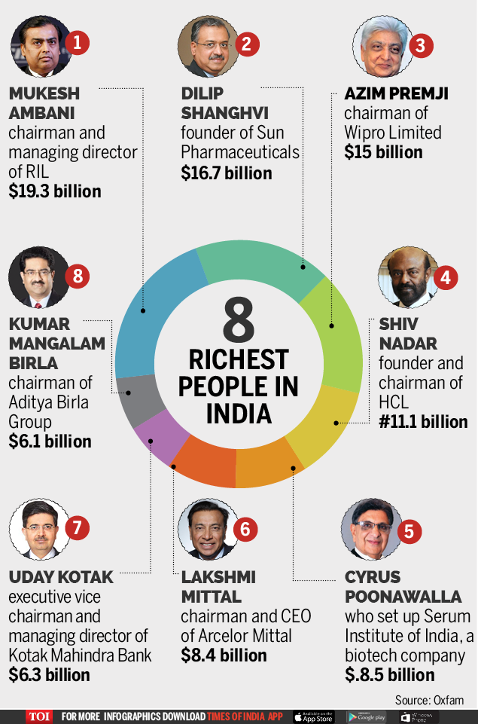
India's rising income inequality: Richest 1% own 58% of total wealth

Slide 54
57 billionaires in India now have same wealth ($ 216 billion) as that of the bottom 70 per cent population of the country.
CEO of India's top information technology firm earns 416 times the salary of a typical employee in his company

Slide 55
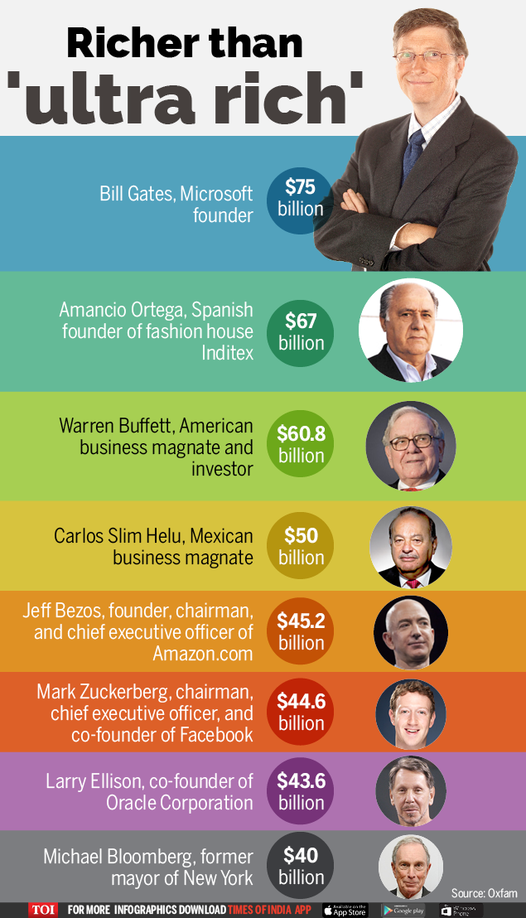
The richest 1 per cent has owned more wealth than the rest of the planet
The total global wealth in the year was $255.7 trillion, of which about $6.5 trillion was held by billionaires, led by Bill Gates ($75 billion), Amancio Ortega ($67 billion) and Warren Buffett ($60.8 billion).

Slide 56
Solutions to basic economic problems

Slide 57
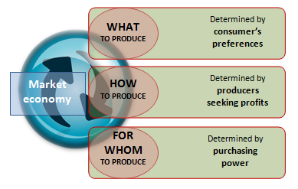
Market Economies
Market economies work by allowing the direct interaction of consumers and producers who are pursuing their own self-interest.
The pursuit of self-interest is at the heart of free market economics.

Slide 58
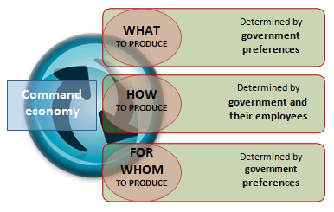
Command/Planned economies
Free markets also fail at times to allocate resources efficiently, so remedies often involve the allocation of resources by government to compensate for these failures.

Slide 59
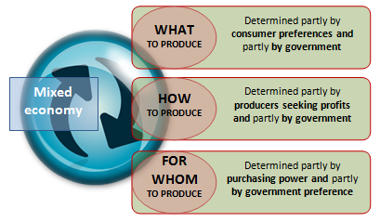
Mixed economies
In reality, all economies are mixed, though there are wide variations in the amount of mix and the balance between public and private sectors.
For example, in Cuba the government allocates the vast majority of resources, while in Europe most economies have an even mix between markets and planning.

Slide 60
Examples - What, How or for Whom to produce ?
Should a company make its own spare parts or buy them from an outside vendor?
Should the company continue to service the equipment it sells or ask the customers to use independent repair companies?
Should a company expand its business to international markets or concentrate or domestic markets?
Should the company replace its telephone operators with a computerised voice messaging system?
Should the company buy or lease the fleet of trucks that it uses to translate its products to markets?

Slide 61
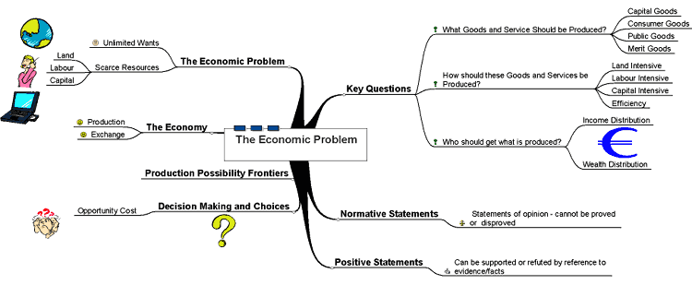

Slide 62
Self-interest in the Social Interest
A choice is in your self-interest if you think that choice is the best one available for you.
A choice is in the social interest if it leads to an outcome that is the best for society as a whole.
The social interest has two dimensions: efficiency and equity (or fairness).
What is best for society is an efficient and fair use of resources.

Slide 63
Big Question
Now let’s ask whether we can organize our economic lives so that when each one of us makes a choice in our self-interest, we actually promote the social interest.
Can trading in free markets achieve this social interest?
Do we need government action to help achieve the social interest?
Do we need international cooperation and treaties to help achieve the social interest?

Slide 64
Examples
Questions about the social interest are hard ones to answer and they generate a lot of discussion, debate and disagreement.
Let’s take a closer look at these questions with two examples:
Globalization
The information-age economy

Slide 65
Globalization
Globalization is in the self-interest of consumers because they can buy low-cost goods and services produced in other countries.
It is also in the self-interest of the multinational firms that produce in low-cost regions and sell in high-price regions.
But is globalization in the self-interest of the low-wage workers in India who are sewing the sequins on your low-cost top or in the interest of displaced clothing workers in London? Is it in the social interest?

Slide 66
While globalization brings expanded production and job opportunities for some workers, it also destroys jobs.
New jobs in India means workers in Europe’s clothing manufacturing industries must learn new skills, take lower-paid service jobs or retire earlier than previously planned.

Slide 67
The Information-age Economy
The Information Revolution has clearly served your self-interest: it has provided your mobile phone, laptop, the latest applications and the Internet.
It has also served the self-interest of Bill Gates of Microsoft and Gordon Moore of Intel, both of whom have seen their wealth soar.

Slide 68
But did the Information Revolution best serve the social interest?
Did Microsoft produce the best possible Windows operating system and sell it at a price that was in the social interest?
Did Intel make the right quality of microchips and sell them in the right quantities at the right prices?
Was the quality too low and the prices too high?
Would the social interest have been better served if Microsoft and Intel had faced competition from other firms?

Slide 69
Microchips and Windows
Gordon Moore, who founded the chip-maker Intel, and Bill Gates, a co-founder of Microsoft, held privileged positions in the Information Revolution.
For many years, Intel chips were the only available chips and Windows was the only available operating system for the original IBM PC and its clones. The PC and Apple’s Mac competed, but the PC has a huge market share. An absence of competition gave Intel and Microsoft the power and ability to sell their products at prices far above the cost of production. If the prices of microchips and Windows had been lower, more people would have been able to afford a computer and would have chosen to buy one.

Slide 70
1.2.1 Production possibility frontier / curve
PPF shows the maximum quantity of goods that can be efficiently produced by an economy, given its technological knowledge and quantity of available inputs
Assumptions:
Scarce input and technology
Considering an economy which produces only two economic goods
The resources are fully and efficiently utilized
Resources are not equally efficient in production of all products. So, when resources are transferred from production of one good to another, the productivity decreases;

Slide 71
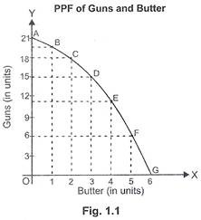
Production possibility curve

Slide 72
Characteristics of PPF
PPF slopes downwards - More of one good can be produced only by taking resources away from the production of another good. As there exists an inverse relationship between changes in quantity of one commodity and change in quantity of the other commodity.
PPF is Concave Shaped - PPF is concave shaped because of increasing marginal opportunity costs, i.e. more and more units of one commodity are sacrificed to gain an additional unit of another commodity.

Slide 73
Whether Economy will always operate on PPF?
Economy will operate on PPF only when resources are fully and efficiently utilised.
Economy will operate at any point inside PPF if resources are not fully and efficiently utilised.
Economy cannot operate at any point outside PPF as it is unattainable with the available productive capacity.

Slide 74
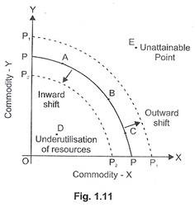
Efficient, attainable & unattainable points

Slide 75
Applying PPF to Society’s choices

Slide 76
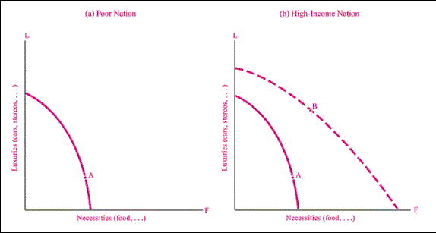
1. Poor nation to High Income Nation
Economic growth shifts the PPF outward
Before development , the nation is poor and devote almost all its resources for necessities. Growth of inputs and technological change shift the PPF outside expanding its consumption of both the goods

Slide 77
Shift in Production Possibility Curve
Shift
Origin
An increase in inputs or improved technological knowledge enables a country to produce more of all goods and services, thereby shifting out the PPF.
Poor countries should devote more towards food production while rich countries towards luxuries

Slide 78
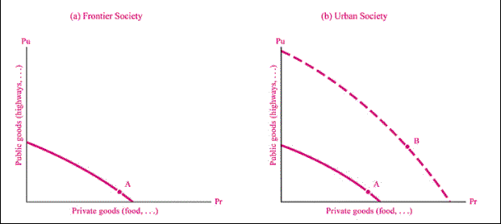
2. Backward Society Vs Urban Society
Economies must choose between Public Goods and Private Goods
A poor society have little resources for public goods like clean air, health whereas a modern urbanized society is more prosperous and chooses to spend more of its higher income on public goods and government services

Slide 79
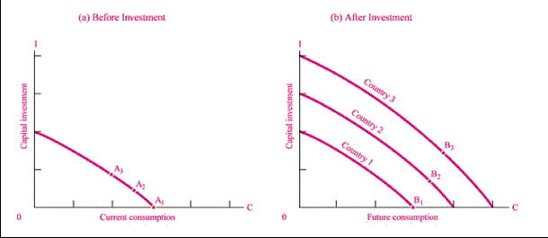
3.Today’s Choices Vs Future Consequences
Investment for Future Consumption Requires Sacrificing Current Consumption
Countries that invest heavily can have both higher investment and consumption in future

Slide 80
Review question
Economic slowdown in some parts of the world adversely affected demand for Indian exports. How will this affect the Production Possibilities Frontier for India?
What will be the impact of large scale outflow of foreign capital on Production Possibilities curve on the economy?
What will be the impact of recently launched ‘Clean India Mission’ (Swachh Bharat Mission) on the Production Possibilities curve of the economy?

Slide 81
Opportunity cost
The opportunity cost of anything is the next best alternative that could be produced
Ex – Farmer, Manager, Government
All decisions which involve choice must involve opportunity cost
The opportunity cost of the funds employed in one’s own business is the interest that could be earned on those funds if they have been employed in other ventures.
The opportunity cost of using a machine to produce one product is the earnings forgone which would have been possible from other products.
The opportunity cost of holding Rs. 1000 as cash in hand for one year is the 10% rate of interest, which would have been earned had the money been kept as fixed deposit in bank.

Slide 82
Marginal analysis
A decision about additional investment is taken on the basis of the additional return from that investment
The marginal concept measures the change in the dependent variable (Cost, revenue, profit) with respect to a unit change in the independent variable
Marginal analysis measures the effect of only one unit change in output

Slide 83
Case let – A new Indian car
On 11 January 2008, Tata, an Indian producer, launched a new model, the Nano. This day it became the cheapest car available, selling for half the price of the next cheapest car. For the price of One lakh rupees ,a brand new Nano could be bought or, for instance, a second hand 1993 Land Rover.
The car is intended initially for the home market. It is thought that millions could be sold in India. The firm also plans to export the car to Latin America. South-east Asia and Africa.
Although selling the car at such a low price will make car ownership more affordable for more people, there are still many millions of people who would like a Car but do not have the income to buy one.
Using examples, identify three factors of production used in making cars.
Give an example of opportunity cost from the passage.
What evidence is there of the economic problem from the passage?

Slide 84
A German travel company consider its future
A German travel company decides to stop selling its holidays in Italy and instead to offer holidays in a new destination. This is the Maldives, a group of islands in the Indian Ocean, famous for their long hours of sunshine and sandy beaches. Tourism is a fast growing industry. Not all families, however, are able to go on holiday whether at home or abroad. Most of those who take holidays would like to have more holiday breaks.
What evidence is there in the passage of scarcity?
Using examples, identify three factors of production involved in providing holidays in the Maldives.
Explain the difference between an economic good and a free good.
Identify a free good from the passage.
Explain the relevance of opportunity cost for a travel firm in deciding how to use its resources.

Slide 85
1.3 Importance of economics in engineering

